Slide 1











Dynamic Smart Traffic Signal Management using Real-Time Vehicle Detection
Page 01
Presented By
Rahul Birawat - U22CS093 Abhinav Choukse - U22CS086 Meet Parmar - U22CS105
Het Patel - U22CS092
Project Guide - Dr. Balu Parne

Slide 2
Problem Statement
Page 02
Current traffic signals run on fixed timers and do not adjust to real-time traffic.
Light-traffic roads face unnecessary delays, while heavy-traffic roads become congested.
This inefficiency increases fuel consumption, travel time, and pollution. A smart, adaptive system is needed to adjust signal timings dynamically based on traffic density.

Slide 3







Motivation & Project Goals
Page 03
Direct Impact: Address one of the most pressing urban issues—traffic congestion.
Deep Learning Application: Opportunity to apply state-of-the-art Computer Vision (Object Detection) to a real-world problem.
Scalability: The proposed camera-based system is cost-effective and easily deployed using existing city infrastructure.
Key Goals (By End of Project):
Achieve real-time, high-accuracy vehicle detection. Implement an adaptive Dynamic Timer Logic.
Reduce average waiting time by X% (Fill in target number).

Slide 4


Literature Survey
Page 04
Dynamic Traffic Light Management System using AI and ML ~ IJERCSE
Paper Summary :
Raspberry Pi + camera sensors for adaptive traffic control Python & OpenCV used for vehicle detection (image processing) Timer formula: 15 + (Vehicle Count / Length), max 90s
Limitations :
No real AI/ML models used (just basic image processing) Simple linear timer logic, not suitable for complex traffic No real-world testing or emergency vehicle handling

Slide 5
Literature Survey
Page 04
Dynamic Traffic Light Management System ~ IRJET
Paper Summary
Uses YOLO (deep learning) for vehicle detection & classification Built with OpenCV + CNN (Darknet framework)
Dynamic timer logic based on vehicle count, type & lanes Tested via a custom simulator (Pygame)
Limitations
Works only for single intersection
No emergency vehicle prioritization or incident detection Simplified timer, not optimal for complex traffic.

Slide 6
Literature Survey
Page 04
Real-time Dynamic Traffic Light ControlSystem with Emergency Vehicle Priority
Paper Summary :
Raspberry Pi + Pi Camera with MATLAB for image processing
Vehicle detection via Background Subtraction + morphological filtering Includes basic ambulance detection (red-color priority)
Limitations :
Very sensitive to lighting/shadows, fails in real-world conditions Poor accuracy in heavy traffic (vehicles merge into one blob) Unreliable ambulance detection (red-color only)

Slide 7
Proposed approach
Page 04
Deep Learning–based Detection: Use YOLO for robust, real-time vehicle detection & classification (cars, bikes, buses, trucks, emergency vehicles).
Dynamic Timer Optimization: Adaptive signal timing based on vehicle type, lane load & queue length, not just raw counts.
Emergency Vehicle Prioritization: Dedicated detection & priority handling for ambulances, fire trucks, etc.
Intersection-Level Design: Built for entire intersections, not just single lanes.
Real-World Integration: Tested with actual traffic video feeds, not limited to simulations.

Slide 8
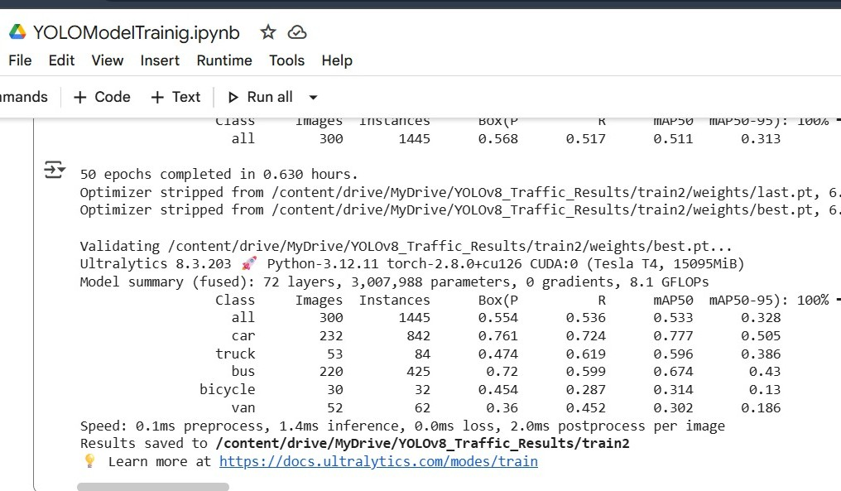





Progress - Model Evaluation (YOLOv8)
Page 07
High Accuracy for Counting (mAP @ 0.50)
Real-Time Speed vs. Localization Trade-Off Validation of Model for Deployment

Slide 9
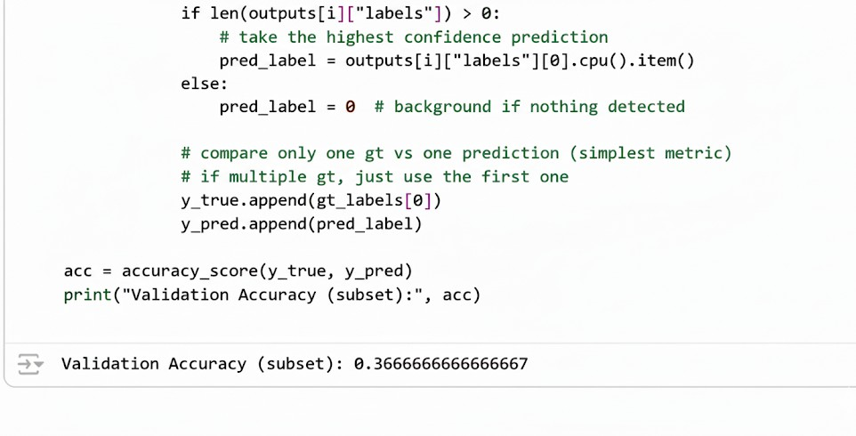
Progress - Model Evaluation (Fast RCNN)
Page 07
Metric is Simplified: The code uses a basic, single-value comparison, resulting in a general "Validation Accuracy (subset)," which is unsuitable for evaluating object localization.
Accuracy is Low ( 36.7%): The low result (0.366...) confirms that the initial training or configuration was insufficient, necessitating a move to better models and metrics.

Slide 10
Progress - Model Evaluation (Mask RCNN)
Page 07
Accuracy - 41%

Slide 11
Why YOLOv8 ?
Page 08
Parameter
Architecture Type
Inference Speed (FPS)
Accuracy (mAP @ 0.50 in Context)
Suitability for Real- Time Traffic
YOLOv8
One-Stage (Speed- optimized)
Very High (30+ FPS, Real-time)
53% (High enough for counting)
Excellent (Fastest & Accurate enough)
Faster R-CNN
Two-Stage (Accuracy- optimized)
Low (5-20 FPS)
36% (Initial Lower Score)
Poor (Too slow, high latency)
Mask R-CNN
Two-Stage + Segmentation Head
Very Low (Heaviest)
41% (Initial Lower Score)
Poor (Too slow & Overkill)

Slide 12

Why not YOLOV9?
Page 09
Ease of use → Ultralytics makes v8 plug-and-play.
Community support → Tutorials, docs, pretrained weights, GitHub issues all focused on YOLOv8.
Anchor-free detection → Simplifies your project pipeline (no anchor tuning headaches).
Deployment → YOLOv8 integrates with ONNX, TensorRT, CoreML, etc. YOLOv9 doesn’t have that ecosystem polished yet.
Industry adoption → Most companies & research labs have standardized on YOLOv8.

Slide 13




Work Done Till Now
Page 10
YOLOv8 Based Vehicle Detection
Implemented object detection using YOLOv8 (pre-trained model). Defined Region of Interest (ROI) on road lanes for focused vehicle counting.
Dynamic Timer Demo Project
Processed sample video with YOLOv8. and Counted vehicles inside ROI for each frame.
Timer logic: Green Light = Base Time + (Vehicles × 3s) (capped at 35s). Output video generated with live overlay of vehicle count in ROI and Calculated dynamic green light time

Slide 14
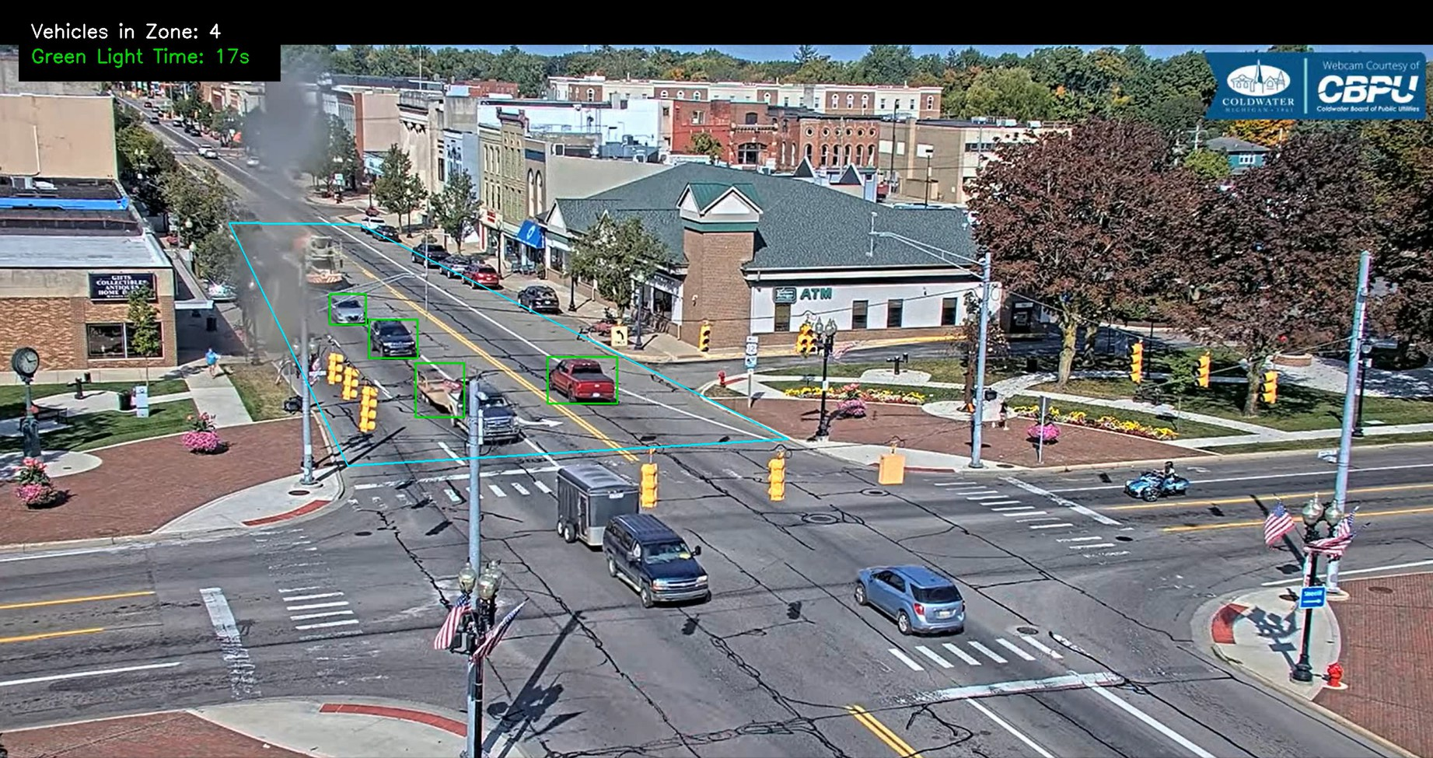
Output Screenshot:
Page 10

Slide 15
Future Scope:
Extend the system from static traffic analysis to handle dynamic traffic flow in real-world intersections.
Study and incorporate insights from standard research papers to refine algorithms and improve system robustness.
Use a Surat-specific dataset to train and validate models for local traffic patterns and conditions.
Add functionality for detection and prioritization of emergency vehicles (e.g., ambulances, fire trucks).
Implement modules for automatic detection of traffic rule violations, such as signal breaking, for improved traffic law enforcement.

Slide 16
Thank You

